Slide 1
IBM Cúram Mobile SDK
Project Update
IBM Cúram

Slide 2
Agenda
Project Recap and Revised Projectt Delivery Iterations
Project Design Revisit
  Impact of CAMMS and IBM MobileFirst Stack Direction
IBM Cúram

Slide 3
Project Vision Statement: IBM should provide a toolkit to our customers and business partners that will enable them to develop Cúram mobile applications
Original View | Proposed Revisions
Playback 0: Complete (16th Sept 2013) Project and assessment of risks and issues Playback 1: Complete (20th Jan 2014) Demo of a simple end to end scenario Playback 2: Architecture Prototyping to mitigate technical risks Cúram Data Service Layer Functionality RSA modelling support Playback 3: <First Product Delivery> Release of Cúram Mobile Software Development Kit (SDK), providing full Worklight integration, development support and inclusion of full production support. Playback 4: Offline Enablement | Iteration 1: December 2014 Release a restricted mobile reference application as an asset outside of product. Iteration 2: Q1 2015 Release of Cúram Data Service Layer (CDSL), providing the ability to develop and expose Cúram data to mobile applications. Potential CDSL exposure on Bluemix Mobile Partner Certification Program Iteration 3: 2015 Release of Cúram Mobile Software Development Kit (SDK) as a cloud service on Bluemix integrated with IBMs MobileFirst Stack.
IBM Cúram

Slide 4
Iteration 1 (Q4 2014) – Cúram Mobile Discovery Asset
Release a restricted mobile reference application as an asset outside of product
Reference Application
  A sample mobile application aimed at illustrating end to end mobile development with Cúram.
  Delivered as Worklight Component
  Underpinned by a limited set of OOTB CDSL APIs (6.0.6), excluding the ability to develop additional APIs.
  Restrictions:
    The reference application is not supported and is suitable for demonstration and education only
Value
  Address the vacuum of information around mobile direction
  Allow customers to experience Cúram mobile development within Worklight
IBM Cúram
Notes:
This is an exposure of Cúram Mobile direction and allows opening dialog with interested customers.
Details on user story for reference application located here: https://w3-connections.ibm.com/wikis/home?lang=en-us#!/wiki/W0a1fd4167cf0_4b87_9de1_934ee047dc09/page/Reference%20Application
The delivery mechanism is currently Worklight, however this is under review based on changes in the MobileFirst stack direction.
Despite this potential change in direction, we believe there is value in exposing some mobile view in 2014.

Slide 5
Iteration 2 : Q1 2015
Cúram Data Server Layer (CDSL)
  Supports the ability to develop and expose Cúram data to mobile applications, using the traditional development stack.
  Potential for CDSL exposure as a service on Bluemix
Value
  Meets need of market feedback, where data access to Cúram is the key concern.
IBM Cúram
Notes:
Market feedback is customers are not interested in UI development (Worklight) and want the freedom on CDSL access point only.
Value: CDSL value as integration point with Bluemix based mobile first stack.

Slide 6
Iteration 3 : 2015
Cúram Mobile Software Development Kit (SDK)
  Aligning SDK with IBMs MobileFirst Stack Direction
    Previous delivery planned as Worklight Integration
    Revised direction : Mobile Development service on Bluemix.
  Challenges being tracked
    IBM development on Bluemix currently restricted
    No exposure of IBM MobileFirst Stack on Bluemix currently
    Ios and what this means now
Value
  Delivers the original project vision statement, enabling business partners and customers to develop mobile applications.
IBM Cúram
Notes:
Bluemix and IBM MobileFirst stack are in very early stages and a full understanding of what is planned and will be delivered is required to develop this picture further.

Slide 7
Project Design Review
MobileFirst Stack Direction Changes
  iOS First
  Future of Worklight
Cúram Data Service Layer
  Review usage patterns for CDSL, widening scope for cloud considerations
  Exposure on Bluemix
    Explore potential as cloud service extension to on-premise solution
    Review Packaging and Licensing decisions
Consideration in CDSL for Analytics Data
  Investigation on leveraging blue stack offerings (e.g. Tealeaf or Worklight)
Development Approach
  Review alignment with traditional Cúram development, which is not compatible with Cloud
IBM Cúram
Notes:
Slide covers the area of the design we are revisiting based on changes in direction in the last year.
https://w3-connections.ibm.com/wikis/home?lang=en-us#!/wiki/W0a1fd4167cf0_4b87_9de1_934ee047dc09/page/Mobile SDK Issue Log
Original CDSL view was for mobile, with integration with Worklight based on JavaScript development. Extending to consider cloud usage pattern/scenarios means OOTB APIs and potentially moving to a full REST service or extending scope of support.
IBM MobileFirst Stack, including Worklight, is changing and evolving to support cloud and bluemix, which puts reliance on Worklight as the development environment of choice in question and will be revisited.

Slide 8
Additional Collateral
IBM Cúram

Slide 9
Glossary
Mobile Software Development Kit (SDK)
  Reference Application (delivered as Worklight Template)
    A sample mobile application aimed at illustrating end to end mobile development with Cúram, underpinned by a limited set of OOTB CDSL APIs.
  Cúram Data Service Layer (CDSL)
    Ability to develop and expose new access paths to Cúram data, in a format suitable for mobile applications
  CDSL Development Library
    A set of JavaScript APIs enabling development of mobile applications with CDSL, currently a Cúram specific Worklight component.
  Integration with IBM MobileFirst Stack (currently Worklight)
    Integration with a platform that supports secure access to Cúram using a mobile application and related mobile back-end services.
Mobile Discovery Asset
  Reference Application (delivered as Worklight Template)
    A sample mobile application aimed at illustrating end to end mobile development with Cúram, underpinned by a limited set of OOTB CDSL APIs.
  Restrictions:
    Preview of CDSL, excluding ability to develop additional APIs and production level support

Slide 10
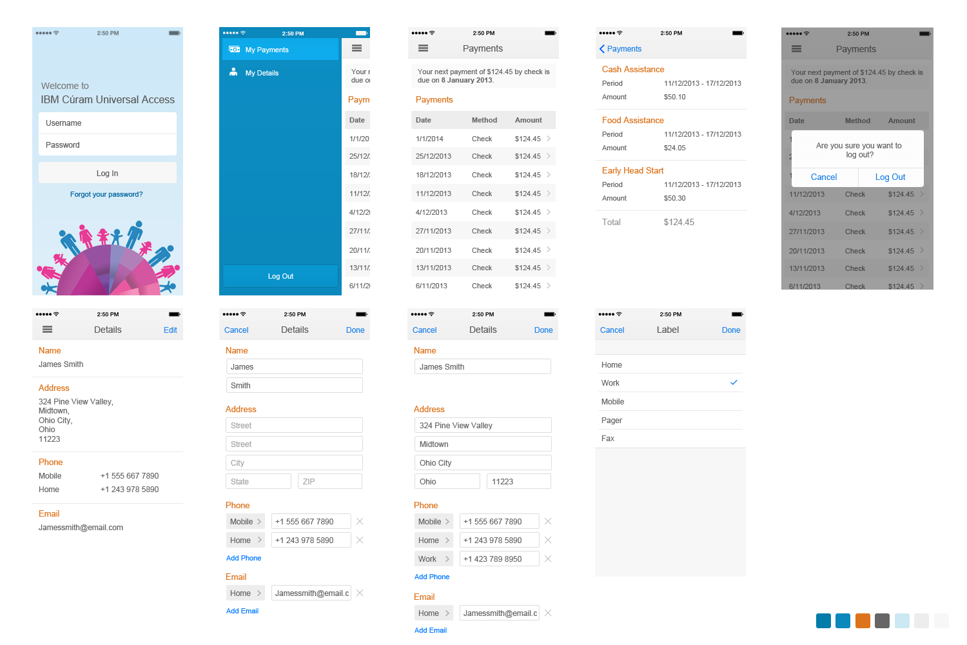
Reference Mobile Application
Proposed Asset for 2014
Carmel is Mobile Application Developer working with IBM lab services on Curam Project , she can integrate the reference mobile application asset with her onsite Curam instance and experience mobile development in under a day.
This will allow Carmel to experience Curam data in mobile paradigm and communicate how this meets her needs.
Notes:
Curam Design: https://w3-connections.ibm.com/wikis/home?lang=en-us#!/wiki/W0a1fd4167cf0_4b87_9de1_934ee047dc09/page/Reference%20Application

